Slide 1
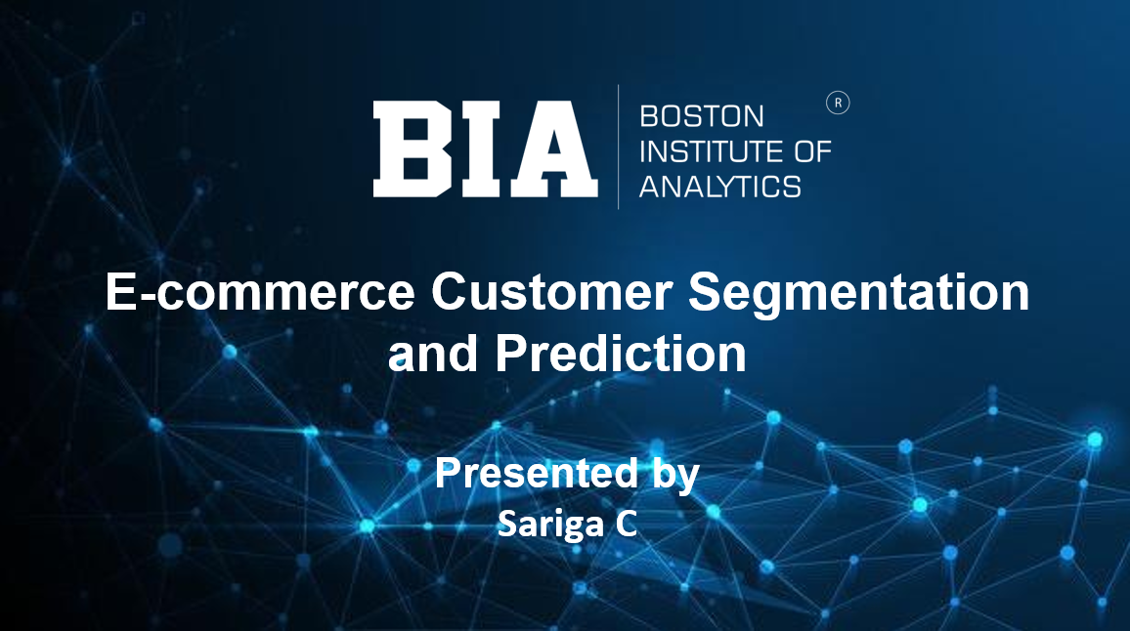
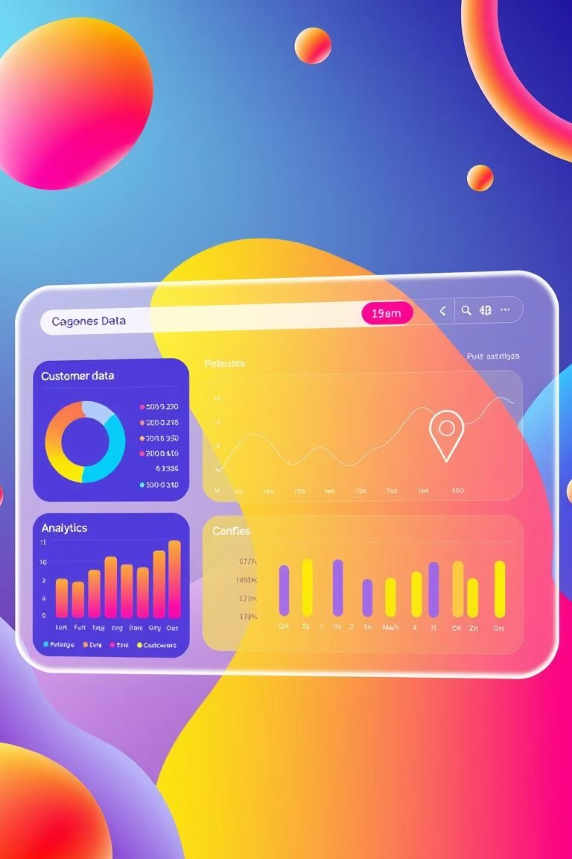
E-commerce Customer Segmentation and Prediction
A Data-Driven Approach to Enhance Marketing and Customer Retention
Presented By:
Sariga C

Slide 2

AGENDA
The Challenge: Inefficient Marketing
Project Overview & Objectives
Dataset Information
Data Cleaning & Preprocessing
Exploratory Data Analysis (EDA
Feature Engineering with RFM
Unsupervised Segmentation
Predictive Classification
Classification Model Comparison
Deployment
Strategic Recommendations

Slide 3
The Challenge: Inefficient Marketing
Generic Strategies
Lack of Understanding
Improvement Opportunity
Leading to low engagement and wasted resources.
No deep insight into customer personas and their value.
Significant potential for personalised satisfaction and retention.

Slide 4



Project Overview & Objectives
Goal: Develop a robust segmentation model and predictive classifier for tailored marketing.
Segment
Predict
Strategise
Categorise customer groups by purchasing behaviour.
Build an accurate model to classify new and existing customers.
Provide actionable recommendations for each segment.

Slide 5

Dataset Information
Analysis performed on a transactional e-commerce dataset.
Source: Online Retail Data
Initial Size: 541,909 transaction records.
Key Attributes:
InvoiceNo : Unique identifier for each transaction
StockCode : Product code
Description : Product name
Quantity : Number of items purchased
InvoiceDate: Date and time of the transaction
UnitPrice : Price per unit of the product
CustomerID: Unique identifier for each customer
Country : Country where the transaction occurred

Slide 6
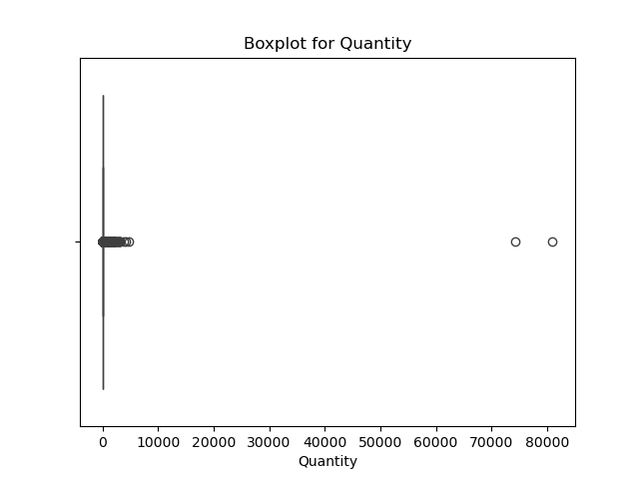
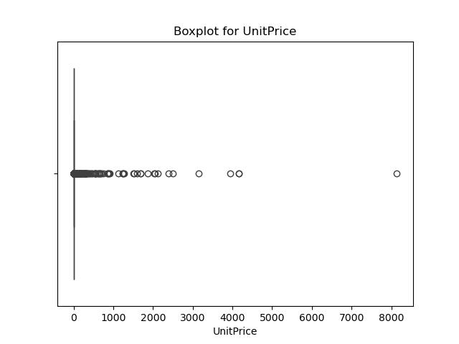
Data Cleaning & Preprocessing
Rigorous cleaning was essential for a reliable model.
Missing Values
----- Removed 135,080 records with no CustomerID.
Cancelled Orders
----- Filtered out transactions with InvoiceNo starting with 'C'.
Invalid Data
----- Removed negative Quantity or zero UnitPrice records.
Outliers
----- Used IQR method for extreme Quantity and UnitPrice outliers
4
Result: Clean dataset of 333,234 transactions.

Slide 7
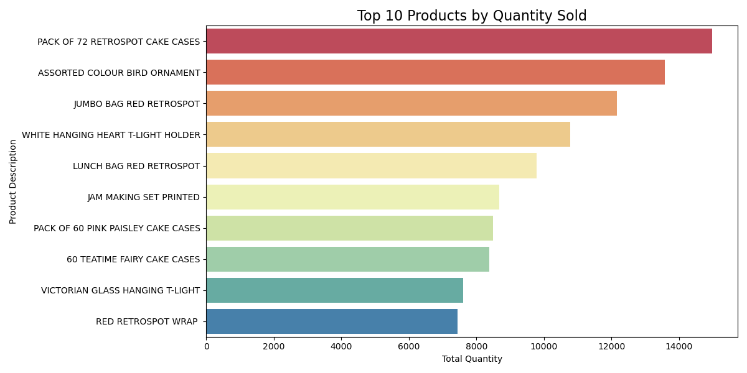
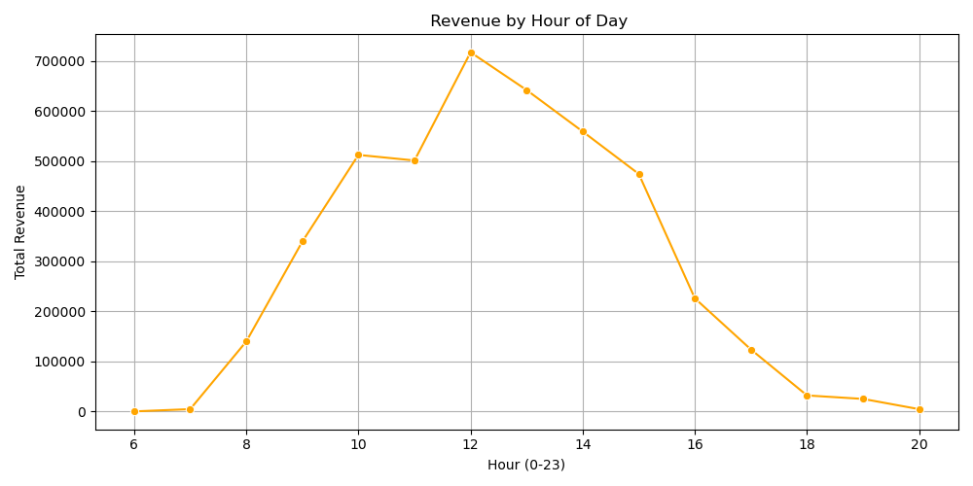
Exploratory Data Analysis (EDA)
EDA provided initial insights into customer behaviour and sales trends.
Product Sales
Revenue Per Day
The most sold products are Cake case, Assorted Colour Bird
Ornaments Jumbo Bag etc..
Marketing is high on the period of 10 a.m to 12 p.m

Slide 8
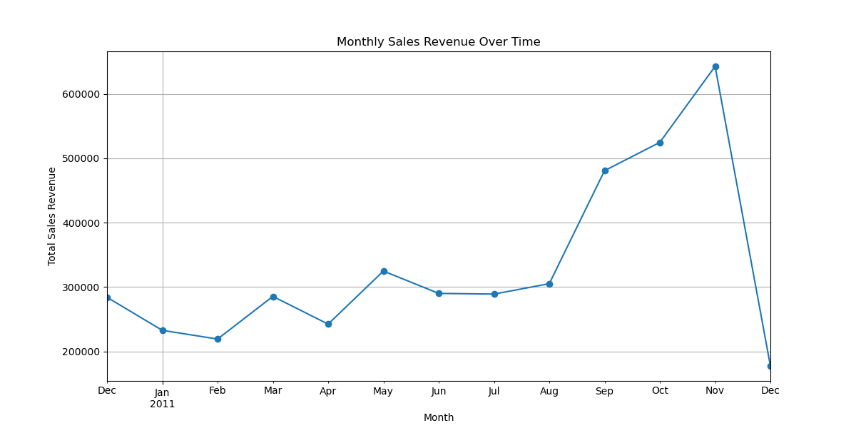
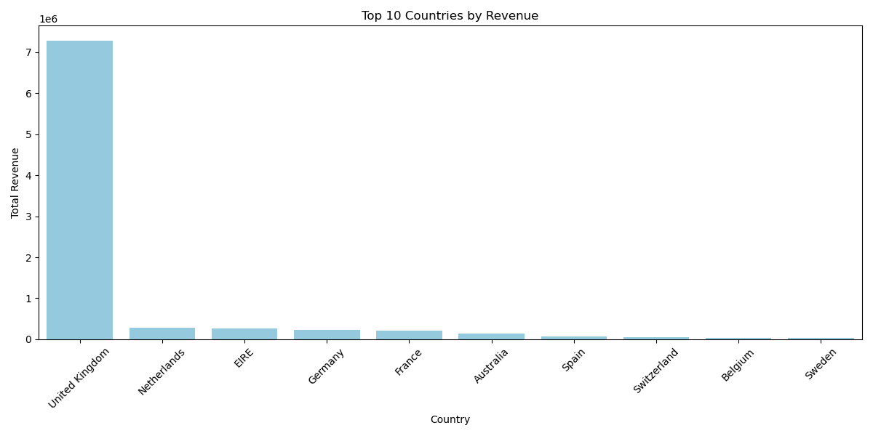
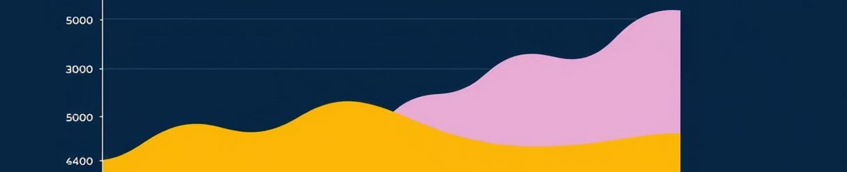
Exploratory Data Analysis (EDA)
EDA provided initial insights into customer behaviour and sales trends.
Geographical Distribution
Sales Trends
Majority of transactions from the United Kingdom.
Significant monthly fluctuations, peaking towards year-end.

Slide 9



Feature Engineering with RFM
Transformed raw transaction data into powerful behavioural metrics.
Recency (R)
Frequency (F)
Monetary (M)
How recently did the customer
make a purchase? (Lower is better)
How often do they purchase?
(Higher is better)
How much do they spend in total? (Higher is better)
These features formed the basis for customer segmentation.
📅 Snapshot Date = max(InvoiceDate) + 1
Applied log1p() to F & M for skew correction
Standardized data with StandardScaler().

Slide 10
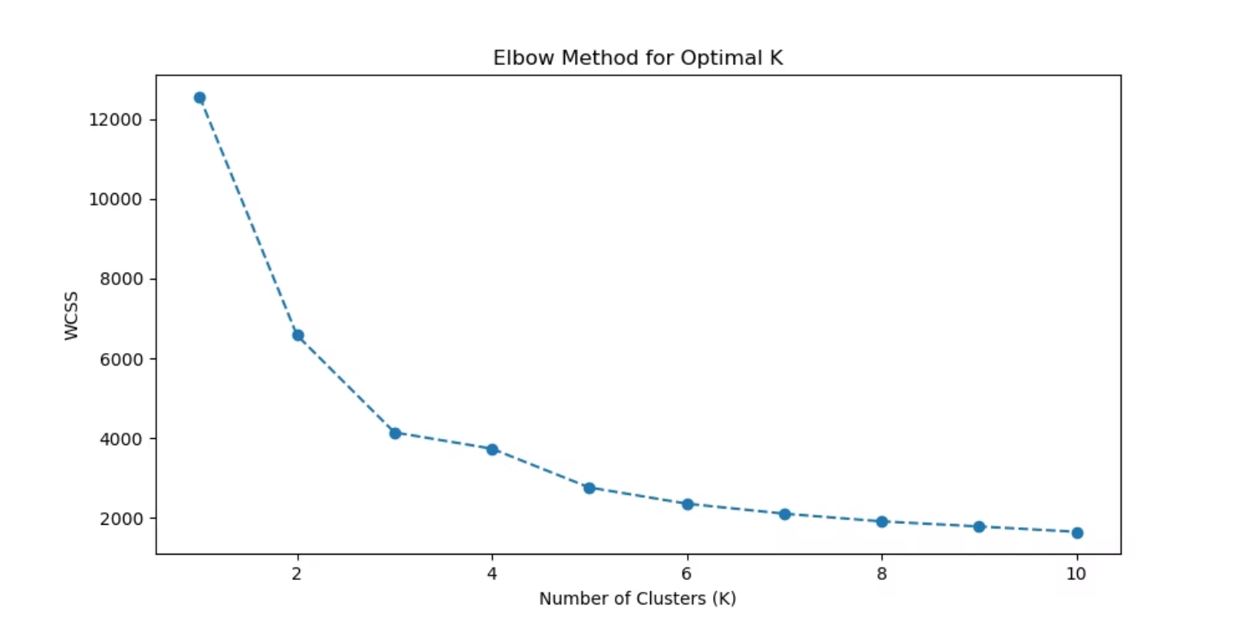
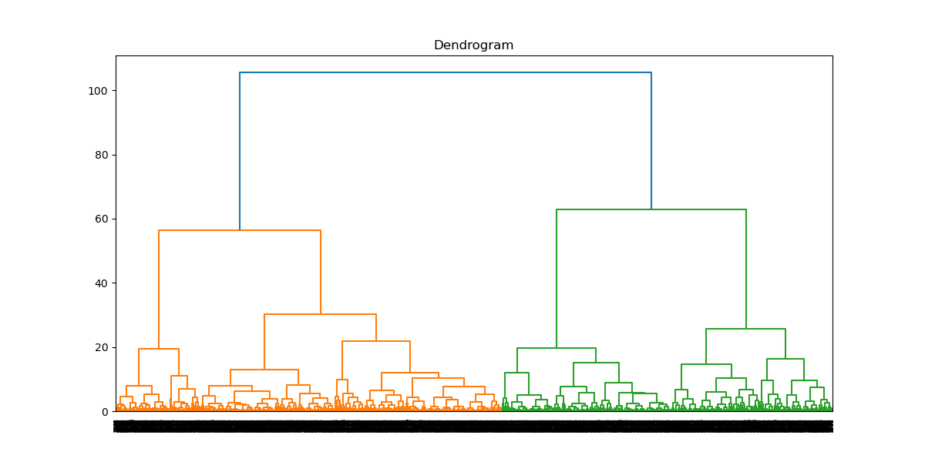
Unsupervised Segmentation
Applied three clustering techniques to group customers based on RFM behavior
K-Means:
Divides customers into K distinct groups based on similarity
(Use Elbow Method)
Hierarchical:
Builds a tree-like structure (dendrogram) to show how clusters are formed step-by-step
DBSCAN:
Groups customers based on density of data points
and can identify outliers (noise)

Slide 11
Clustering Model Comparison
K-Means, Hierarchical, and DBSCAN models evaluated.
Algorithm
Silhouette Score(high value)
Davies-Bouldin Index(lower)
Calinski-Harabasz Score(high)
K-Means
0.354
0.964
3721.28
Hierarchical
0.298
1.076
3371.45
DBSCAN
0.319
2.793
1181.27
Winner: K-Means Clustering selected for superior performance and interpretability.

Slide 12
Segment Profiling
K-Means, Hierarchical, and DBSCAN models evaluated.
Cluster | Segment Name | RFM Profiling
0 | At-Risk Spenders | High Recency, Low Frequency, Low Monetary
1 | Loyal Customers | Medium Recency, High Frequency, High Monetary
2 | Lost Customers | Very High Recency, Very Low Frequency, Very Low Monetary
3 | Potential Loyalists | Low Recency, Medium Frequency and Medium Monetary
4 | Champions | Low Recency, High Frequency, High Monetary

Slide 13
Predictive Classification
Predict customer segments using RFM values with machine learning models.
Process:
Used 6 models to Train:
Used Recency, Frequency, Monetary as input features.
Target variable: Customer Segment
Logistic Regression
Random Forest
Decision Tree
Gradient Boosting
SVM
KNN
Train-Test Split with stratify=y
Label Encoding of segments
Feature Scaling with Standard Scalar
Trained models can classify new customers into segments for personalized marketing and
customer retention

Slide 14
Classification Model Comparison
Model
Accuracy
Precision
Recall
F1-Score
Logistic Regression
94.16
0.94
0.94
0.94
Random Forest
97.85
0.98
0.98
0.98
Gradient Boosting
97.14
0.97
0.97
0.97
Decision Tree
96.42
0.96
0.96
0.96
SVM
94.52
0.95
0.95
0.95
KNN
94.59
0.96
0.96
0.96
Random Forest was selected as the best model due to its highest accuracy (98.85%) and balanced performance across
all classification metrics

Slide 15
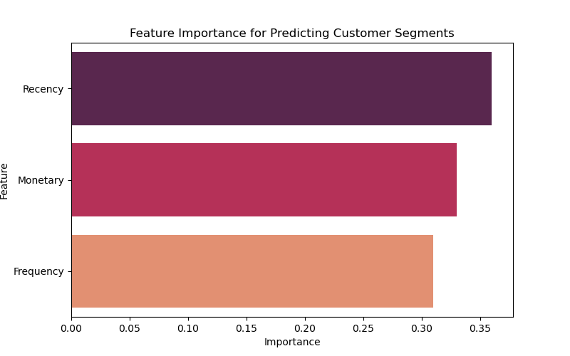
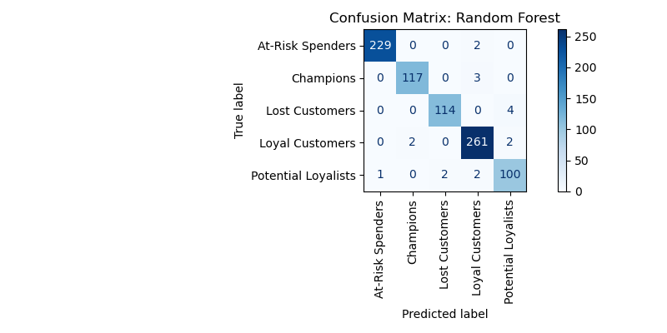
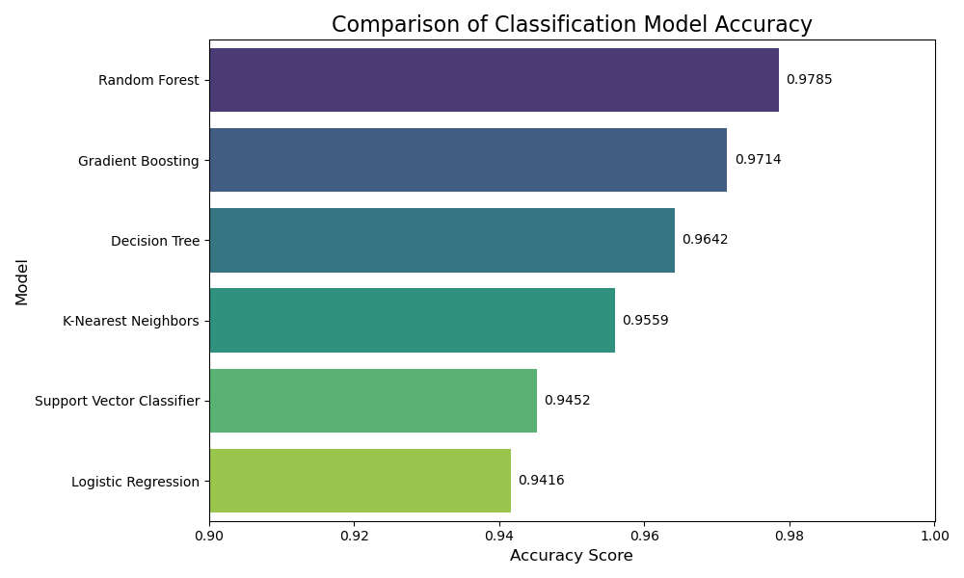
Model Interpretation

Slide 16
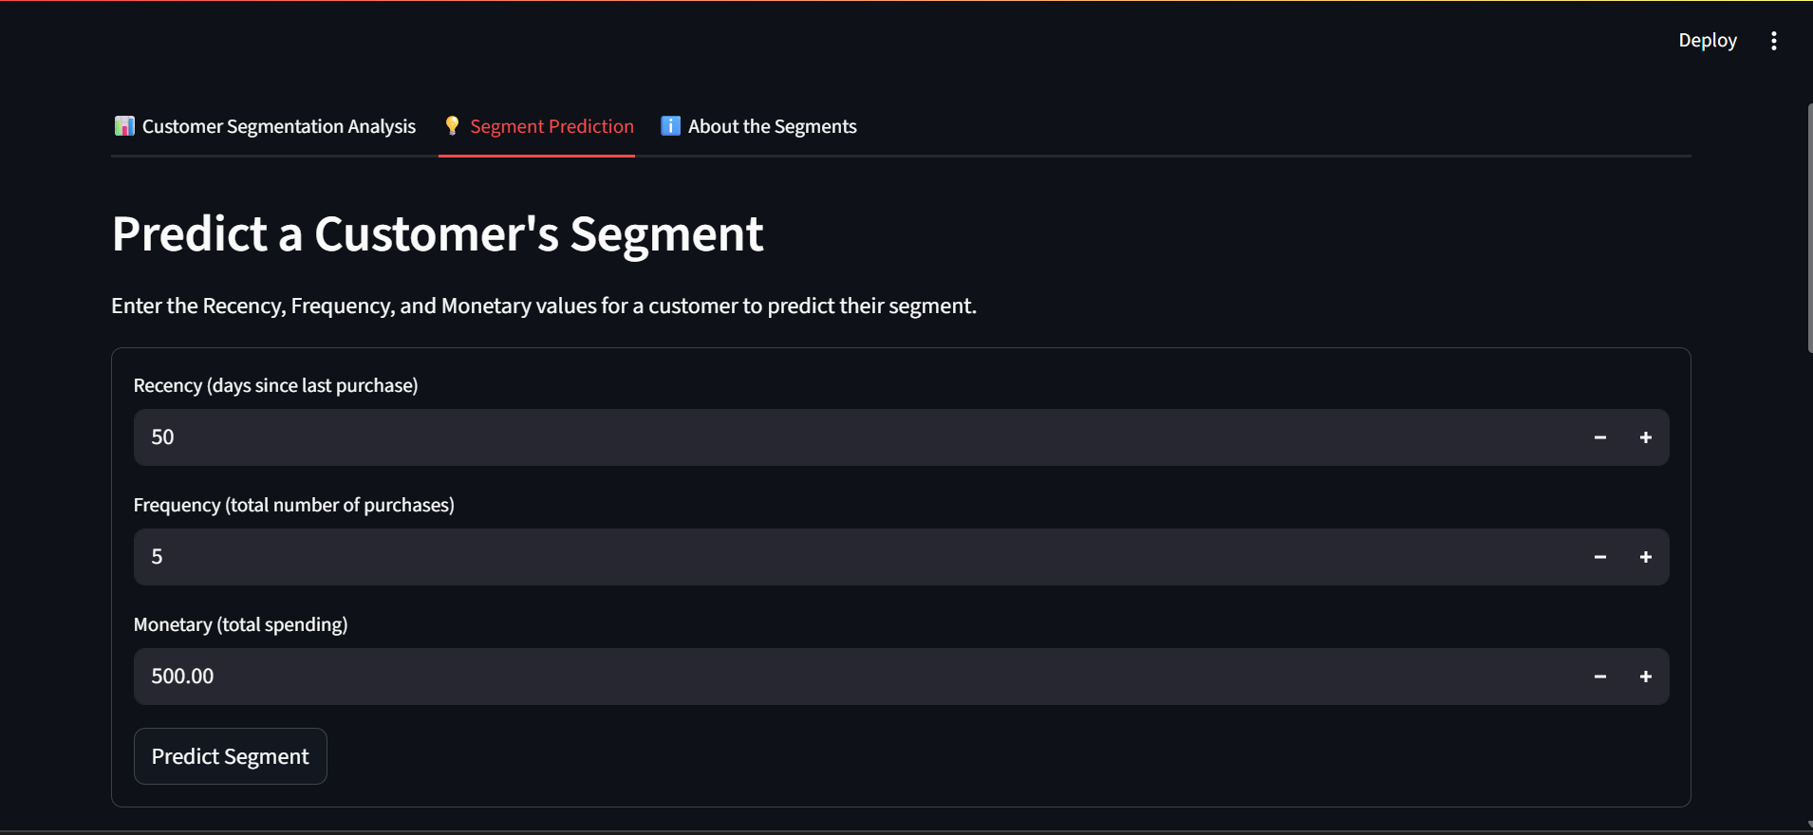
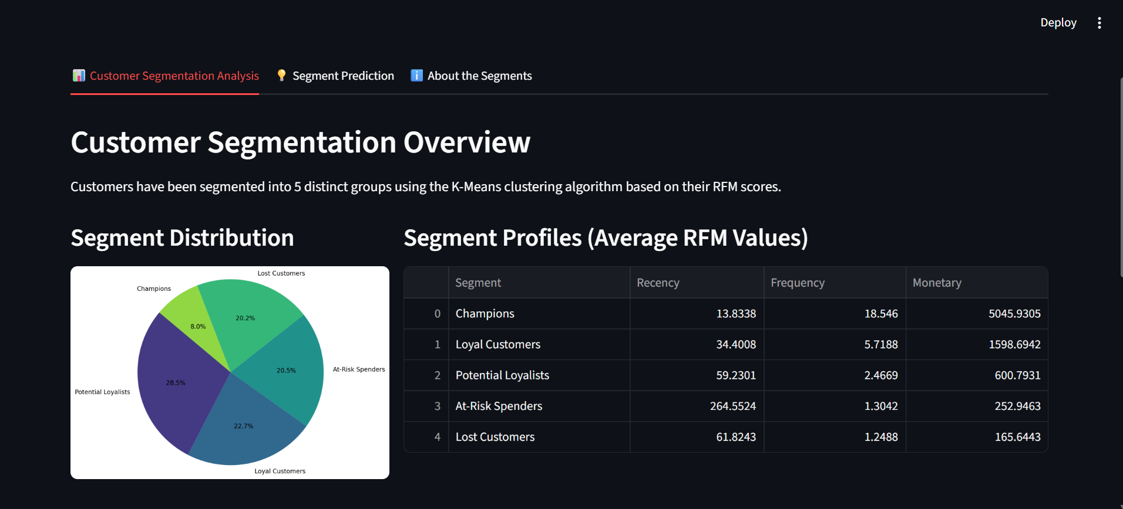
Deployment
Interactive web interface for classifying customers based on RFM values using the Streamlit

Slide 17
Strategic Recommendations
Champions:
Reward & Retain. Offer loyalty programs, exclusive access, and seek advocacy
Loyal Customers:
Upsell & Engage. Recommend new products and ask for reviews
Potential Loyalists:
Nurture & Grow. Use personalised onboarding and introductory offers
At-Risk Spenders:
Reactivate Urgently. Launch targeted "win-back" campaigns with discounts
Lost Customers:
:Low-Effort Approach. Minimal re-engagement, focus on higher-value segments

Slide 18
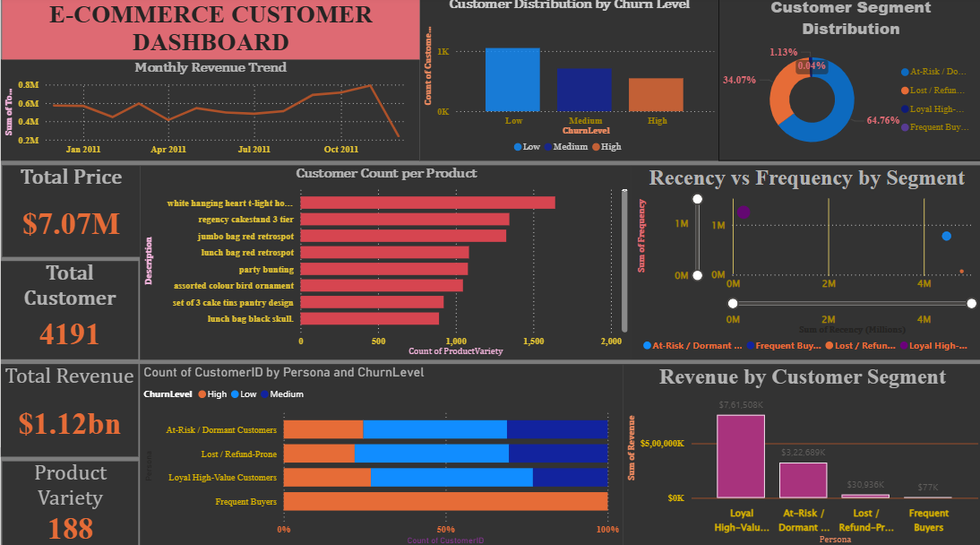
DASHBOARD

Slide 19
QUESTIONS ?

Slide 20

THANK YOU
QUESTIONS ?

